Slide 1
Assessing the Impact of Re-engineering on Software Security
Presented By:
Team 7
Shreya Reddy Gade
Yogesh Kalapala
Sivathejeswara Reddy Komma
Nalini Pasupuleti

Slide 2
Coding Assignment 1&2: MavAppoint & SAMS
Reused Requirements:
Hashed Passwords : Stored the passwords using the hashing method in the database.
Calendar : Appointments made reflect on the calendar.
Edit Appointments : Ability to cancel or reschedule appointments.
Modified Requirements:
Register Student: Create a one-time account and use it to schedule appointment with advisors.
Email : A temporary password will be sent to the particular email when first time logged into the account and send a reminder email to the student email.
Created Database schema by getting the requirements from the given code.

Slide 3
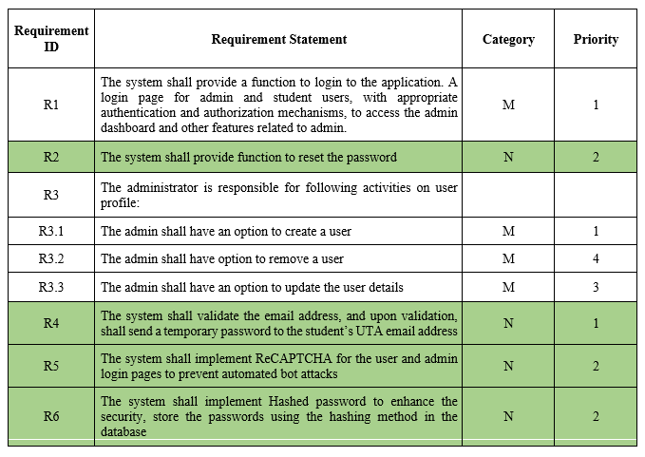
Coding Assignment 2: Samsdb
Requirements:
M- Modified
N- New
R- Reused
1- Highest priority

Slide 4
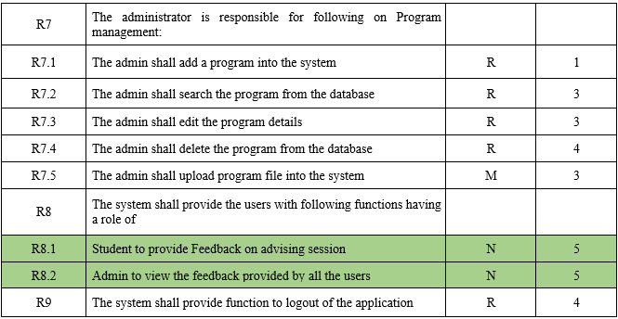
Requirements Contd…

Slide 5
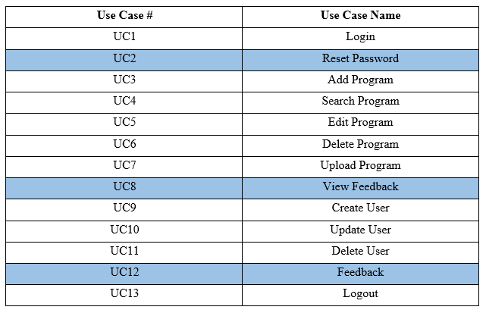
Use Cases:

Slide 6
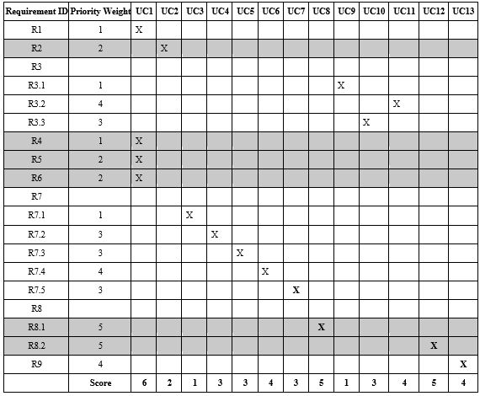
Requirements To Use Case Traceability Matrix:
1- Highest priority
5- Lowest priority

Slide 7
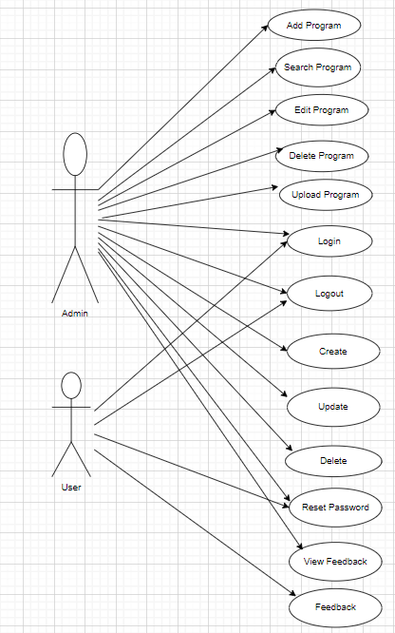
Use Case Diagram:
Users: Admin, Student
Admin
Student

Slide 8
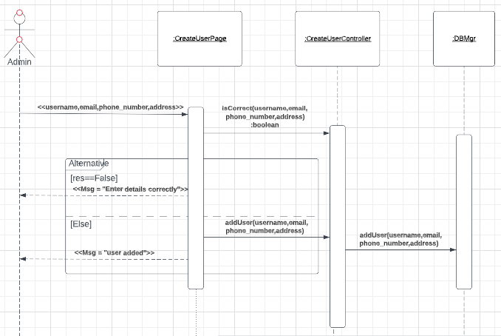
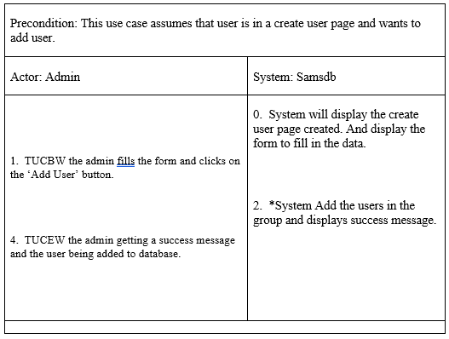
Sequence Diagram:
Create User:

Slide 9
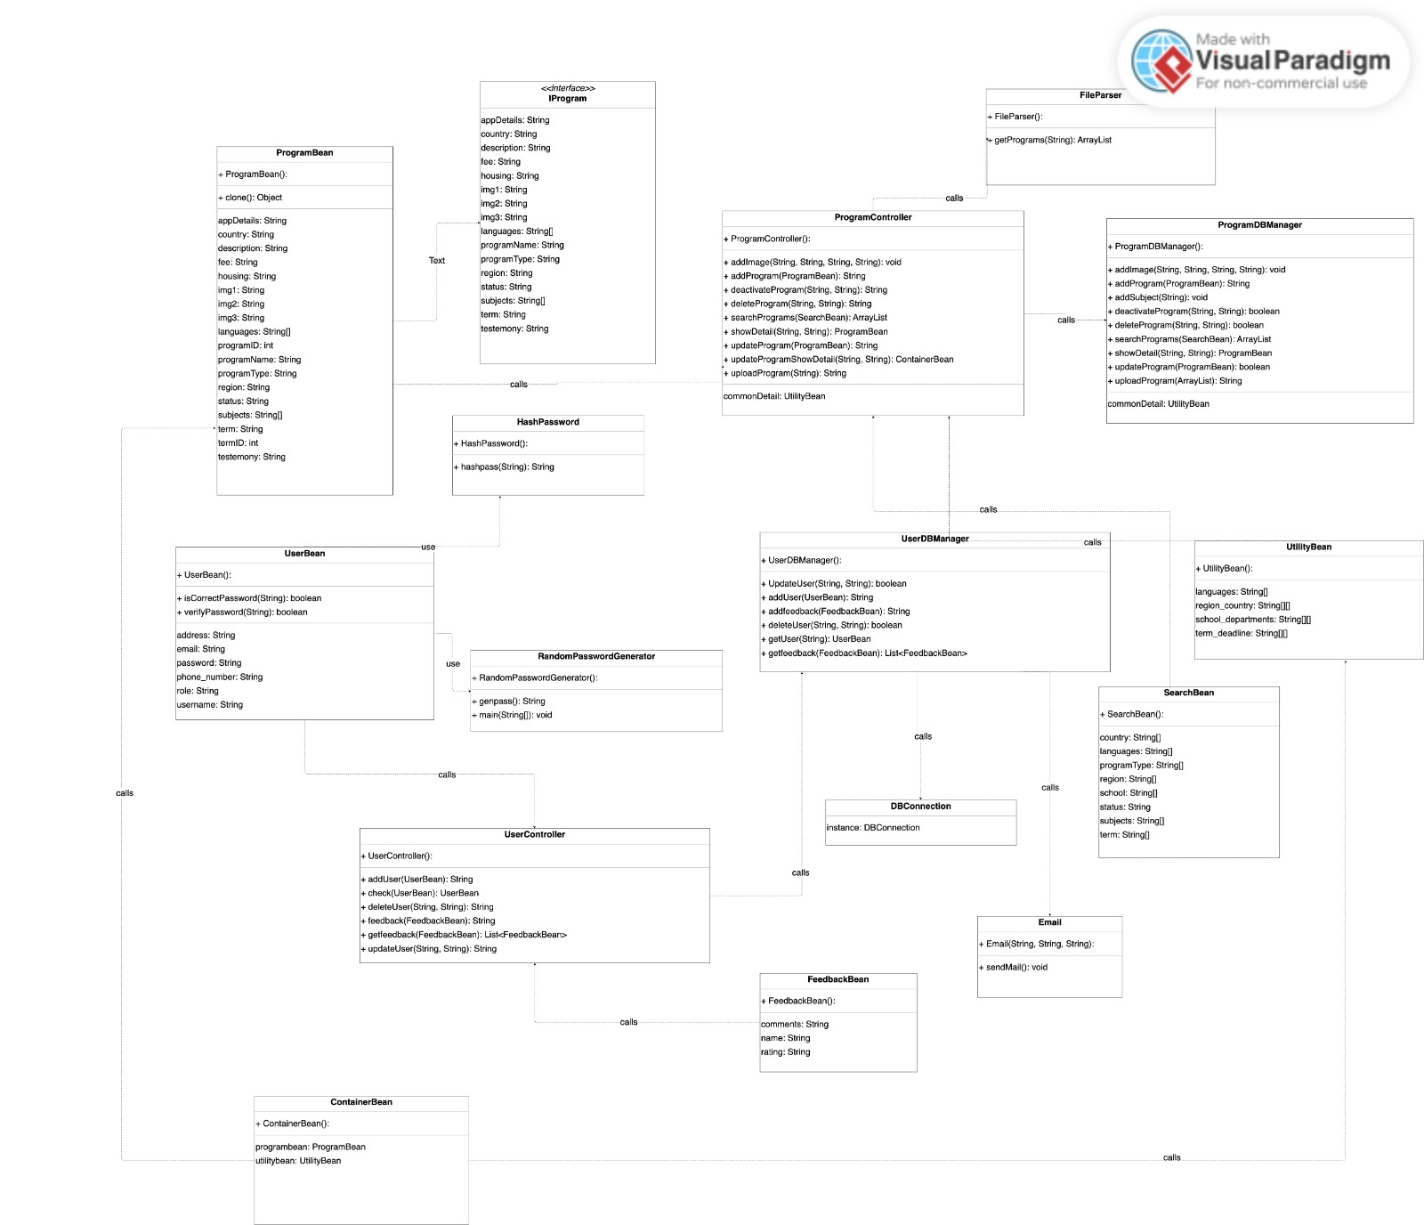
Domain Class Diagram:

Slide 10
Paper Title: Assessing the Impact of Re-engineering on Software Security
Authors: Shreya Reddy Gade, Yogesh Kalapala, Sivethejeswara Reddy Komma, Nalini Pasupuleti
Year: 2023
Main Idea:
Software reengineering is essential to keep up with rapidly evolving technology, user expectations, and business objectives.
Reengineering, however, may also result in the introduction of fresh security holes that may harm people and software systems.
During the reengineering process, security safeguards must be put in place by developers, users, and organizations to protect against security threats.
By following best practices and suggestions for lowering security risks, the software reengineering process can be made safer and more resilient.
Case studies have been conducted to support our assertions.
Software systems can be badly harmed by a number of security hazards, including viruses, malware, hacking, and cyberattacks. These risks can also result in data breaches, endanger user privacy, and compromise system security.
making sure that software systems are secure and resistant to potential security attacks is crucial.

Slide 11
Paper Title: Assessing the Impact of Re-engineering on Software Security
Authors: Shreya Reddy Gade, Yogesh Kalapala, Sivethejeswara Reddy Komma, Nalini Pasupuleti
Year: 2023
Motivation:
Software Re-engineering and Security
In order to mitigate these risks, it is crucial to review best practices and guidelines for limiting the effects of software reengineering on security. Software re-engineering entails changing existing code to increase usability, stability, and the ability to be maintained.
It can aid companies in adapting to new demands and maintaining their competitiveness.
However, re-engineering could also result in the creation of fresh security holes.
Software security involves creating, constructing, and testing secure software.
It tries to reduce software flaws that raise the risk of being vulnerable to attack.
During the early stages of the development cycle, developers can identify potential vulnerabilities by conducting unbiased risk analyses and testing on all software components.
Language-based weaknesses like SQL injection attacks, cross-site scripting (XSS) attacks, and buffer overflow attacks can be avoided by using secure coding practices like input validation and output encoding.
Setting security as a top priority early on can help to lower risks and guarantee dependable, effective, and affordable software systems.
hazards to security throughout the reengineering process.

Slide 12
Paper Title: Assessing the Impact of Re-engineering on Software Security
Authors: Shreya Reddy Gade, Yogesh Kalapala, Sivethejeswara Reddy Komma, Nalini Pasupuleti
Year: 2023
Reengineering Methodology
Reverse Engineering: Utilize models to create abstract representations.
Security Analysis: Identify vulnerabilities and their potential impact
Model Transformation: Update models with security enhancements and best practices
Forward Engineering: Generate new code adhering to desired security properties
Validation and Verification: Conduct rigorous security testing to validate and verify effectiveness of enhancements
Tools
Reverse Engineering Tools: extract information about the existing software system
Model Transformation Tools: transform extracted information into models for analysis
Model Analysis Tools: analyze the transformed models to identify issues
Code Refactoring Tools: modify existing codebase to adhere to new design
Automated Testing Tools: perform functional, performance, and security testing of re-engineered system.

Slide 13
Paper Title: Assessing the Impact of Re-engineering on Software Security
Authors: Shreya Reddy Gade, Yogesh Kalapala, Sivethejeswar Reddy Komma, Nalini Pasupuleti
Year: 2023
Result:
Goals and objectives: Different methodologies have different goals, e.g., Model-Driven Re-engineering (MDRE) focuses on identifying vulnerabilities at the model level, while Architecture-Centric Re-engineering (ACRE) addresses security vulnerabilities arising from architectural flaws.
Techniques and tools: Re-engineering methodologies employ various techniques and tools for security improvement, such as security patterns, static analysis tools, and penetration testing.
Security improvements: Results indicate that different methodologies achieve varying degrees of security improvements depending on their goals, techniques, and tools, and the system's context.
Limitations:
Complexity of software systems: During the re-engineering process, it might be challenging to find and fix all potential security flaws due to the complexity of current software systems.
Limited security expertise: The efficient application of re-engineering processes and procedures is frequently hampered by the lack of security expertise among software developers and engineers.
Resource limitations: It can be challenging to allocate sufficient resources for improvements to security because the re-engineering process can be time- and resource-intensive.
Weakness:
Older and poorly maintained software is vulnerable to known bugs and vulnerabilities.
Incompatibility with the latest security measures and updates puts sensitive data at risk.
Reengineering allows for necessary system reorganization or redesign, but can also introduce vulnerabilities.
Following reengineering and security models is crucial to mitigate security risks.
Various models for software reengineering and security can complement each other to enhance system security performance.

